Slide 1
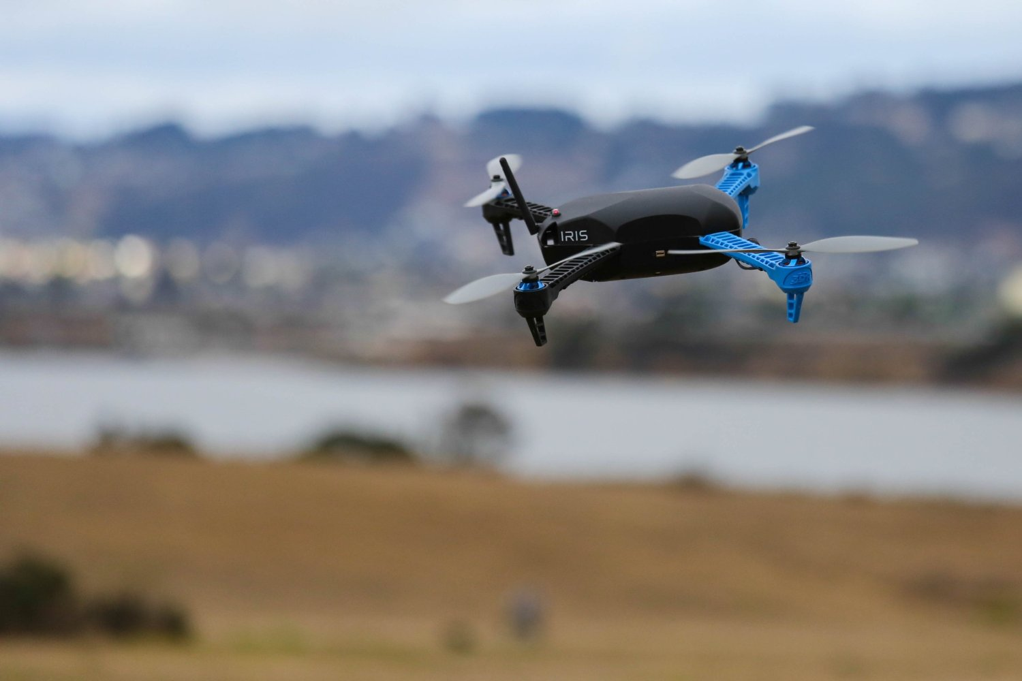
Autonomous Delivery Quadcopter
Mark Milhouse Raed Tawil
Notes:
Mark

Slide 2
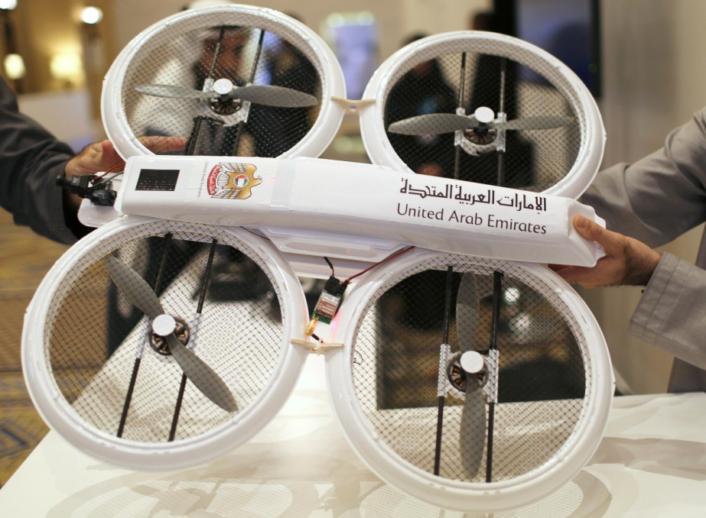
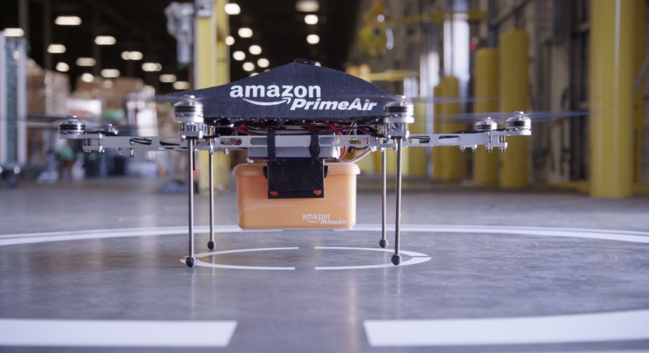
Introduction
Delivery Drones
UAE
Amazon Prime Air
Notes:
Mark

Slide 3
System Overview
Mobile App
Server
Quadcopter
Package Delivery System
Notes:
Ray

Slide 4
Hardware Components
Sets of Motors, Arms, Legs, and Propellers
Drone Shell
RC Transmitter
Ground Station Radio
Notes:
Ray

Slide 5
Software
Pre-existing components
Pixhawk
MAVLink
MAVProxy
Necessary additions
Server Backend
Phone App
Notes:
Mark

Slide 6
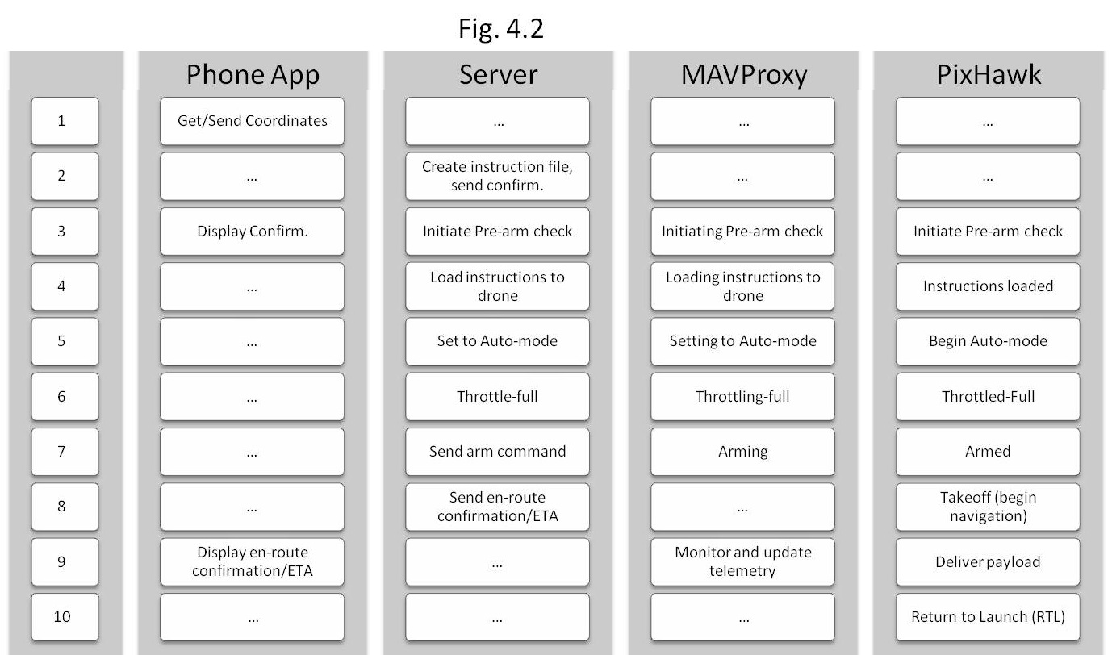
Software Process
Notes:
Mark

Slide 7
Communications Overview
SERVER
DRONE
MAVProxy
MAVLink
Pixhawk
Serial
Server
Phone
User
IP

Slide 8
Experiments
Testing Calibration
Testing Flight Modes
Testing MAVLink
Testing Server
Testing Android App
Testing Wind Resistance
Testing GPS Accuracy
Notes:
Ray

Slide 9
Obstacles
Calibration
Software integration
Deciphering undocumented standards
Wind
Replacement parts
Open space

Slide 10
 | QGC WPL 110
 | index | current | altmode | cmd | param1 | param2 | param3 | param4 | param5 | param6 | param7 | auto
WAYPOINT | 1 | 1 | 1 | 16 |  |  |  |  | 41.94288 | -87.648 |  | 1
WAYPOINT | 2 | 1 | 1 | 16 | DELAY | HIT RAD |  | YAW ANG | LAT | LONG | ALT | 1
LOITER TURNS | 3 | 1 | 1 | 18 | TURNS |  | DIR 1=CW |  | LAT | LONG | ALT | 1
LOITER TIME | 4 | 1 | 1 | 19 | TIME (S) |  |  |  | LAT | LONG | ALT | 1
LOITER UNLIMITED | 5 | 1 | 1 | 17 |  |  |  |  | LAT | LONG | ALT | 1
RTL | 6 | 1 | 1 | 20 |  |  |  |  |  |  |  | 1
LAND | 7 | 1 | 1 | 21 |  |  |  |  |  |  |  | 1
TAKEOFF | 8 | 1 | 1 | 22 |  |  |  |  |  |  | ALT | 1
ROI | 9 | 1 | 1 | 80 |  |  |  |  | LAT | LONG | ALT | 1
DO SET ROI | 10 | 1 | 1 | 201 |  |  |  |  | LAT | LONG | ALT | 1
COND DELAY | 11 | 1 | 1 | 112 | TIME (S) |  |  |  |  |  |  | 1
COND CHANGE ALT | 12 | 1 | 1 | 113 | RATE (CM/S) |  |  |  |  |  | ALT | 1
COND DISTANCE | 13 | 1 | 1 | 114 | DIST (M) |  |  |  |  |  |  | 1
COND YAW | 14 | 1 | 1 | 115 | DEG | SEC | DIR 1=CW | REL/ABS |  |  |  | 1
DO JUMP | 15 | 1 | 1 | 177 | WP# | REPEAT# |  |  |  |  |  | 1
DO CHANGE SPEED | 16 | 1 | 1 | 178 | SPD (M/S) |  |  |  |  |  |  | 1
DO SET HOME | 17 | 1 | 1 | 179 | CURRENT(1)/ SPEC(0) |  |  |  |  |  |  | 1
DO SET CAM TRIGG | 18 | 1 | 1 | 206 | DIST (M) |  |  |  |  |  |  | 1
DO SET RELAY | 19 | 1 | 1 | 181 | OFF(0)/ ON(1) | DELAY(S) |  |  |  |  |  | 1
DO REPEAT RELAY | 20 | 1 | 1 | 182 |  | REPEAT# | DELAY(S) |  |  |  |  | 1
DO SET SERVO | 21 | 1 | 1 | 183 | SER NO | PWM |  |  |  |  |  | 1
DO REPEAT SERVO | 22 | 1 | 1 | 184 | SER NO | PWM | REPEAT# | DELAY (S) |  |  |  | 1
DO DIGICAM CONTROL | 23 | 1 | 1 | 203 |  |  |  |  |  |  |  | 1
DO MOUNT CONTROL | 24 | 1 | 1 | 205 |  |  |  |  |  |  |  | 1

Slide 11
Results
Major Milestones
Manual flight
Simulated autonomous flight
Fully autonomous flight
Conclusions
Wind turbulence
Accurate calibration/checks
Pixhawk expandability
Extended flight (5k)
Full autonomy
Performance in open spaces
Notes:
Mark

Slide 12
Future Scope
Delivery Mechanism
Battery Power For Stronger Motors
Sensors Network
More Advanced Algorithms
Notes:
Ray

Slide 13
Questions?
Notes:
Ray

